Slide 1


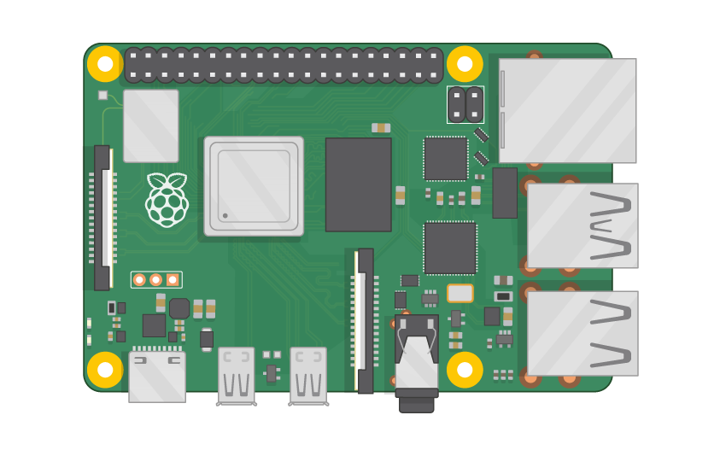
Raspberry Pi Master Class Day-4
Interface External ADC | Analog

Slide 2
Table of Contents
01
02
03
04
Analog to Digital Converter
SPI
Overview
Serial Peripheral Interface
Analog sensor Interface
Discussion & Q&A
Analog sensor interface with external ADC
Interractive session

Slide 3
PREREQUISITES FOR THIS COURSE
Raspberry Pi 3 Model b/B+
16 GB SanDisk class 10 SD Card
Card reader
Laptop with Internet
Power Adapter – 5V 2Amps
USB B-Type Cable
MCP3008
Breadboard
Analog sensor

Slide 4
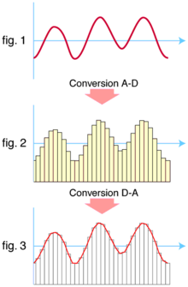
Analog to Digital converter…
An ADC converts a continuous-time and continuous-amplitude analog signal to a discrete-time and discrete-amplitude digital signal.
The conversion involves quantization of the input, so it necessarily introduces a small amount of error or noise.
Furthermore, instead of continuously performing the conversion, an ADC does the conversion periodically, sampling the input, limiting the allowable bandwidth of the input signal.

Slide 5
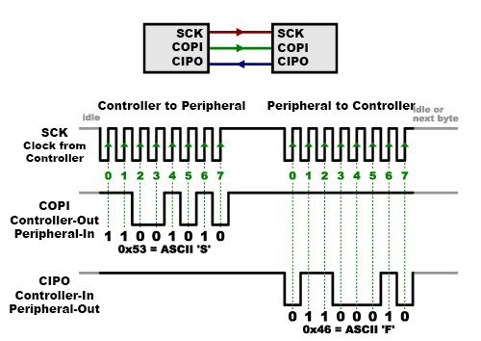
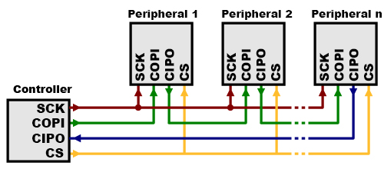
Serial Peripheral Interface
Serial Peripheral Interface (SPI) is an interface bus commonly used to send data between microcontrollers and small peripherals such as shift registers, sensors, and SD cards.
It uses separate clock and data lines, along with a select line to choose the device you wish to talk to.

Slide 6
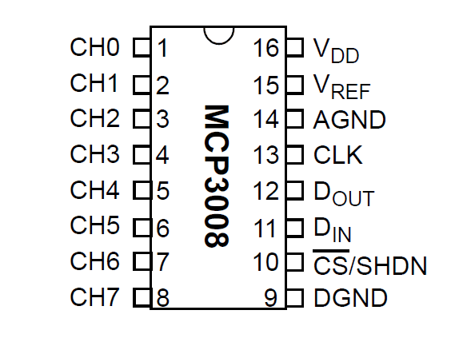
MCP3008 ADC…
The MCP3008 is a low cost 8-channel 10-bit analog to digital converter.
The MCP3008 connects to the Raspberry Pi using a SPI serial connection. You can use either the hardware SPI bus, or any four GPIO pins and software SPI to talk to the MCP3008.
Software SPI is a little more flexible since it can work with any pins on the Pi, whereas hardware SPI is slightly faster but less flexible because it only works with specific pins.
If you aren't sure which to use I recommend software SPI as it's easier to setup

Slide 7
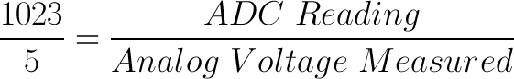
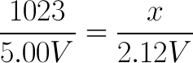
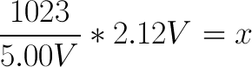
Relating ADC value to Voltage

Slide 8
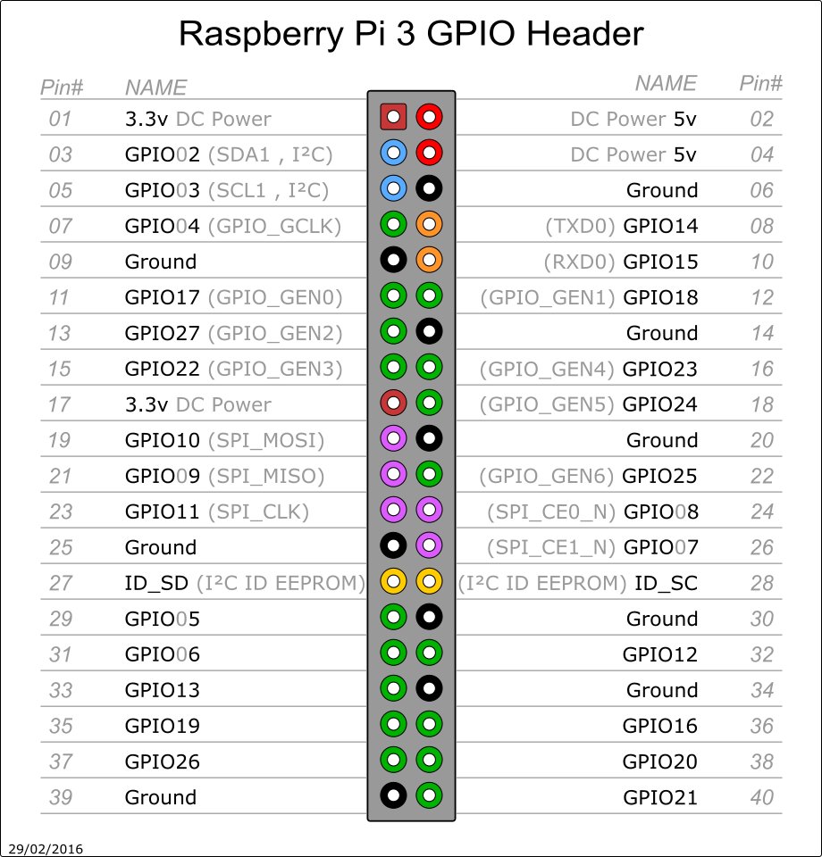
Pin Out of RPi3

Slide 9
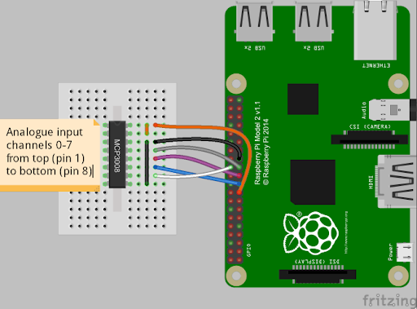
MCP – Ext. ADC

Slide 10
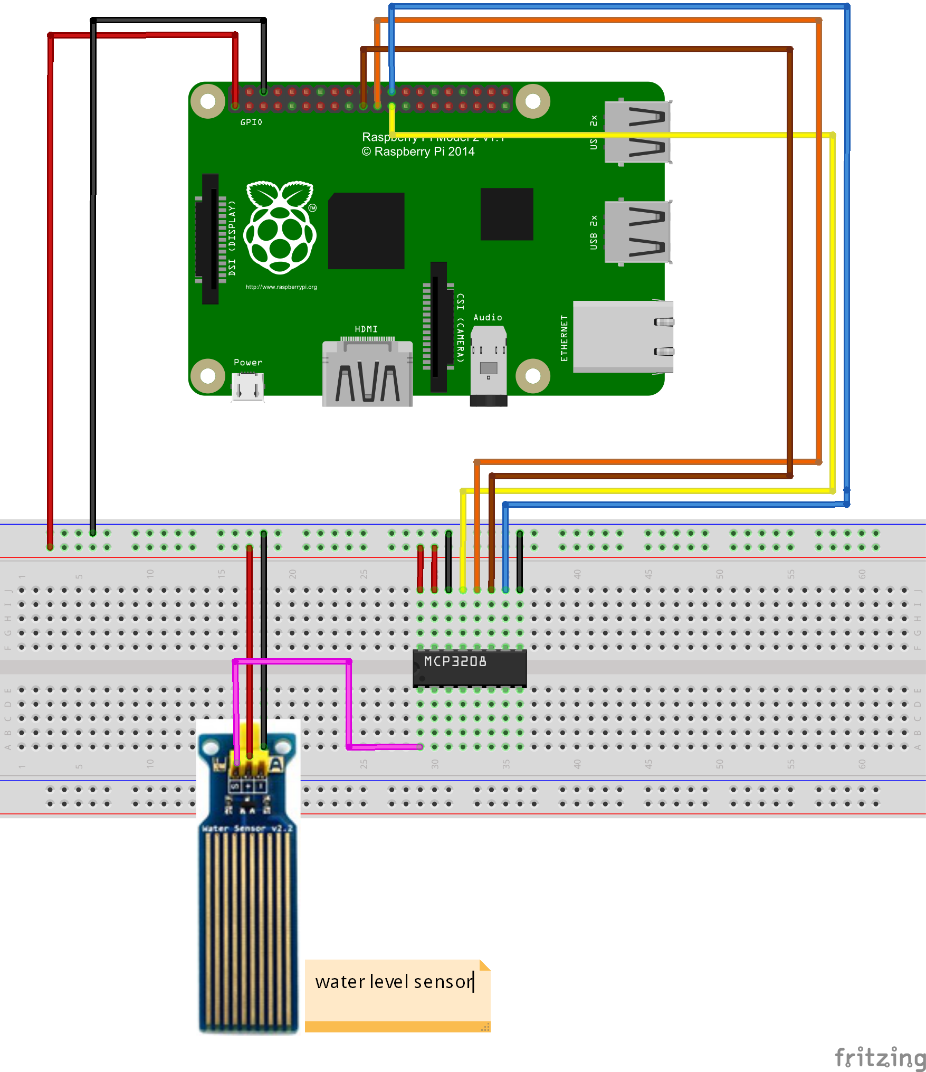
Analog Sensor- ADC

Slide 11
Informative
Interractive
Interesting
Daily Science Discussion
Question/Day
Discussion on Next Day
Learn Science !

Slide 12

Q3 – Discussion
Albert Einstein first predicted the existence of black holes in 1916, with his general theory of relativity
The first object considered to be a black hole is Cygnus X-1. Cygnus X-1 was the subject of a 1974 friendly wager between Stephen Hawking
A black hole and its shadow have been captured in an image for the first time, a historic feat by an international network of radio telescopes called the Event Horizon Telescope (EHT)
Katie Bouman (above) had to develop algorithms to take 5 petabytes of data and make sense of it.
Black Hole

Slide 13
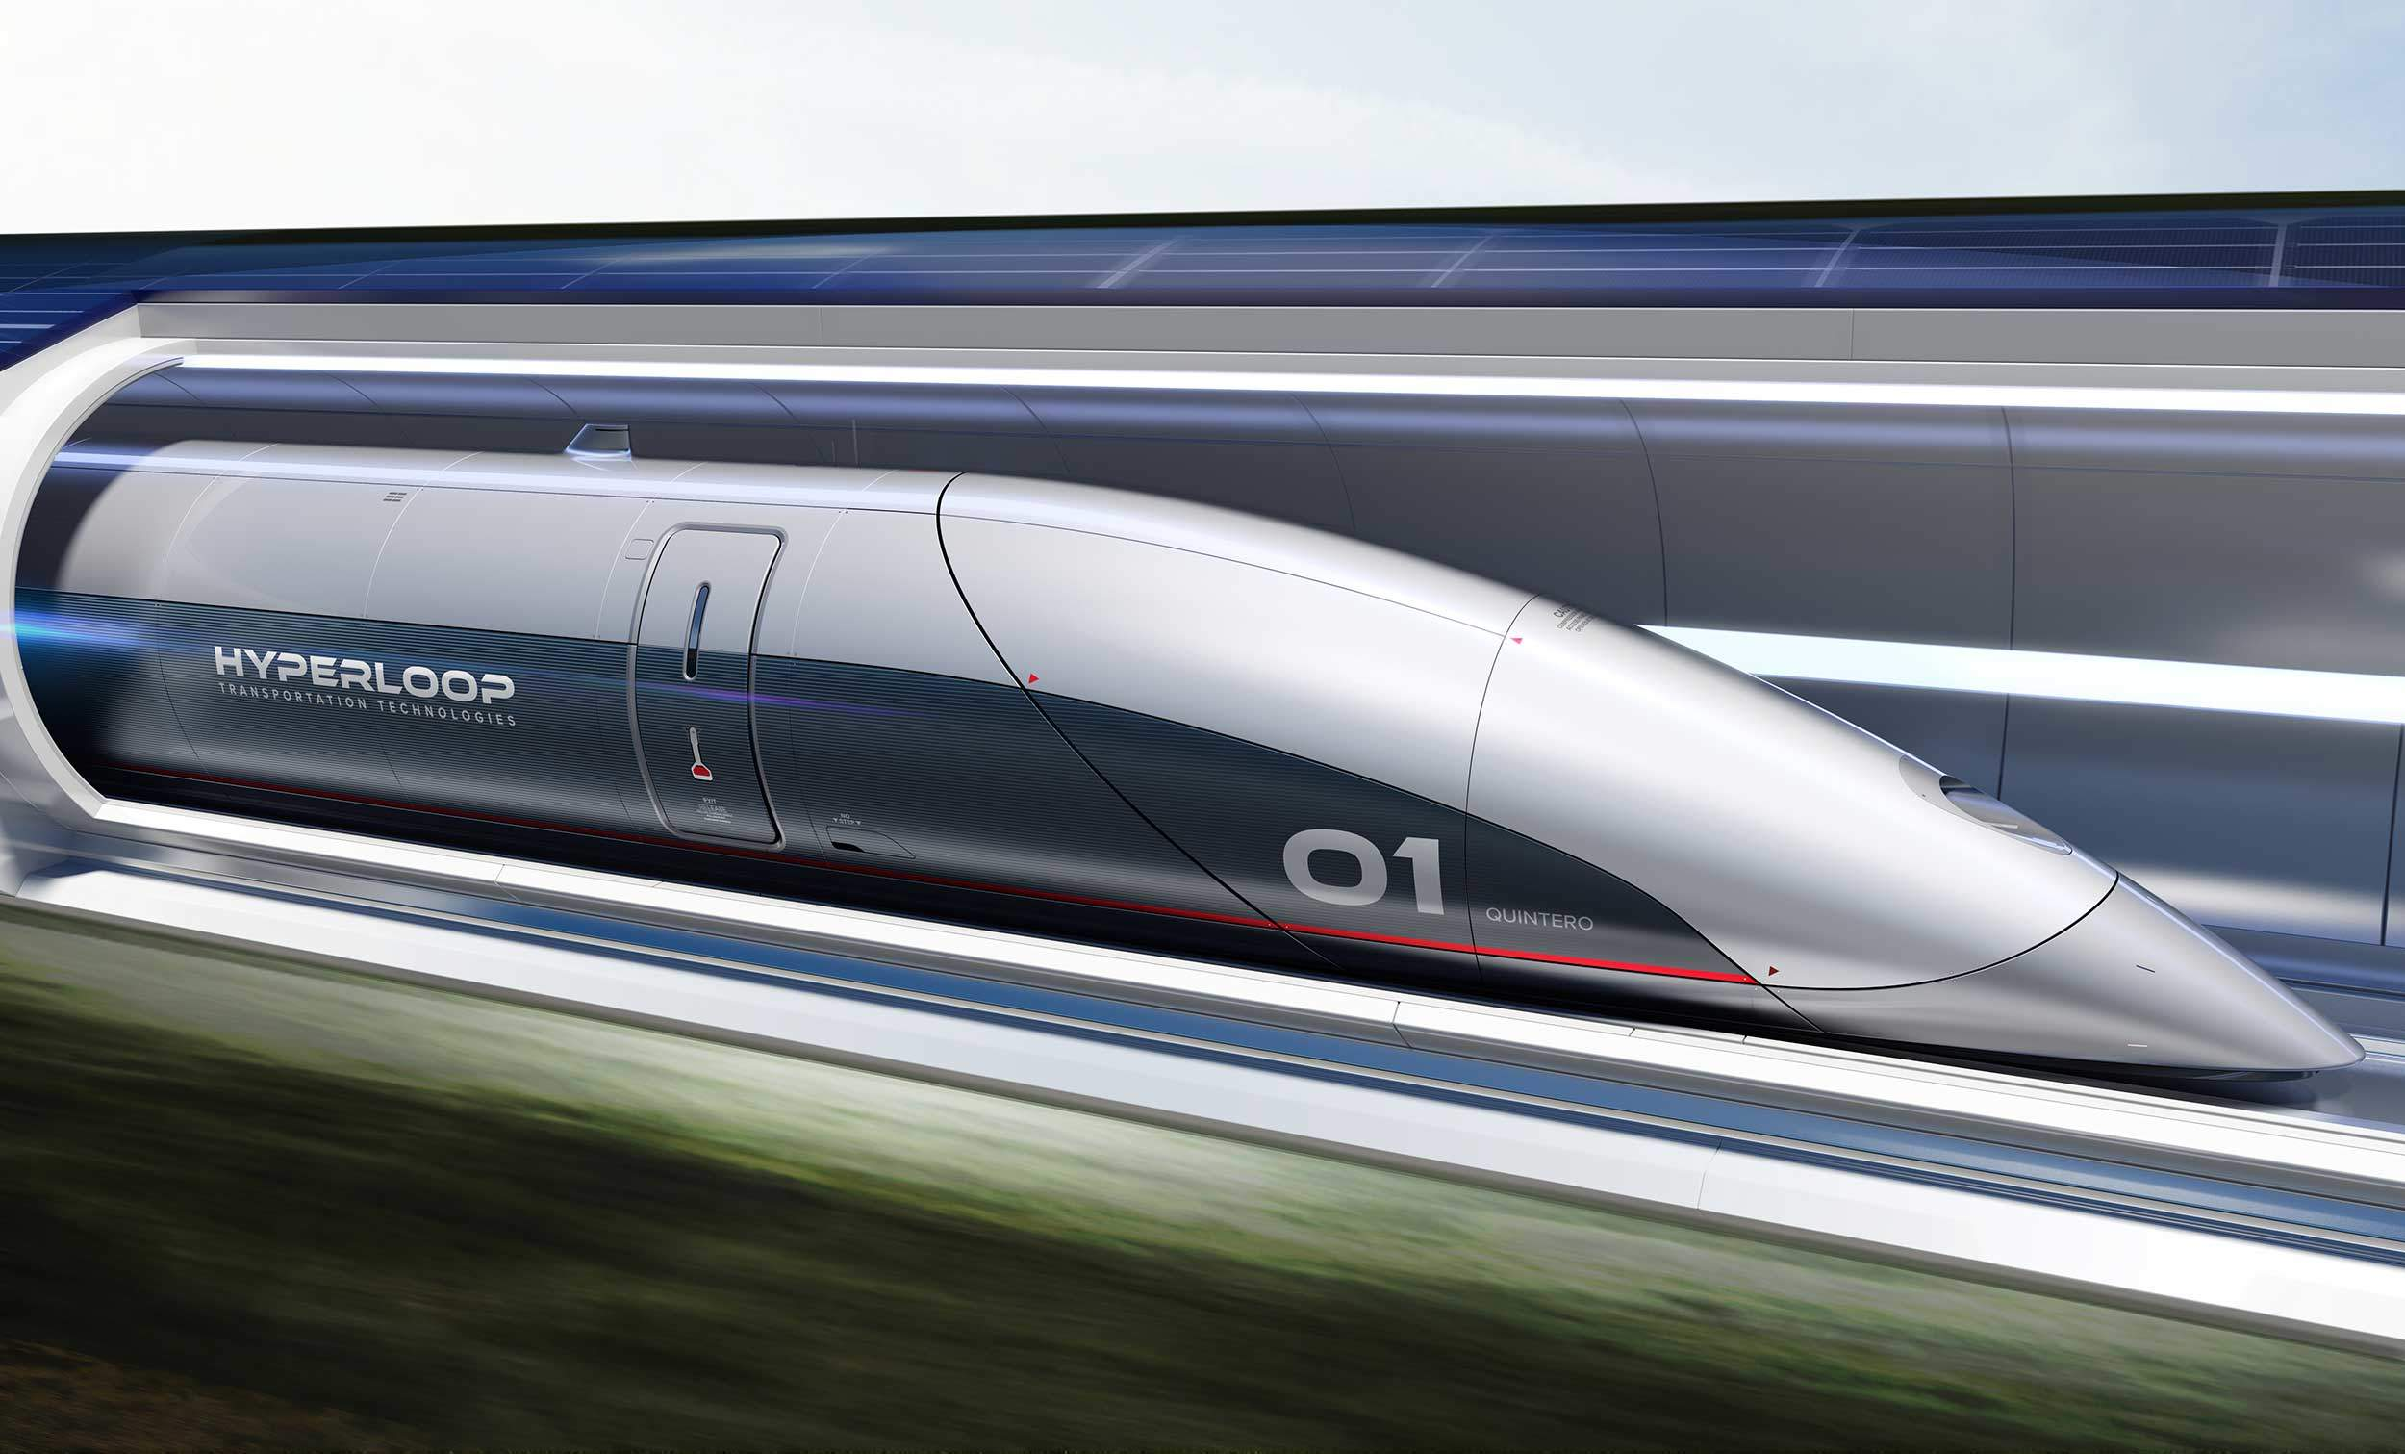
Q4 – Discussion
Hyperloop

Slide 14

Jet Fuel From CO2? Breakthrough Could Make Air Travel Carbon Neutral
Tech News - 4
Dec - 2020
A team of researchers from Oxford University has successfully managed to turn carbon dioxide (CO2) into jet fuel, though as of now the experiment was performed at a very small scale. As concerns about climate change keep mounting by the day, scientists have been looking into converting CO2 into sustainable, synthetic hydrocarbons fuels for transportation purposes for a few years now.

Slide 15


Thanks!
learn.pantechsolutions.net
www.pantechsolutions.net
“Live ur life as an exclamation rather than an Explanation”
- Isaac Newton

